Slide 1
US Exchange Research Database
INFO 7290 - Fall 2020
Presented by:
Dimple Bapna, Vaibhavi Gaekwad, Wasinee Opal Sriapha, Yufei Wang

Slide 2
Agenda
Mission Statement
Data Description
Data Architecture
Data Integration Design
Data Integration Workflow
Analyses and Visualizations
Conclusion

Slide 3
Mission Statement
The aim of this project is to build a data warehouse and a system that:
Automate daily API data-extraction in AWS for stock prices
Integrate and transform the daily data along with other associated financial data (e.g. valuation ratio, earnings and income statement, etc.)
Load the clean and transformed data to a DW and a star schema for specific technical analyses
Present the analyses in a visualization format using Tableau dashboard

Slide 4
Datasets
Four companies from four different sectors: Health Care, Technology, Financials, and Energy (1 company/sector) will be analyzed using the five datasets below.
Alpha Vantage Inc.
Stock Time Series Daily Data
Company Overview
Earning Report
Income Statement
YCharts Inc.
Valuation Data

Slide 5
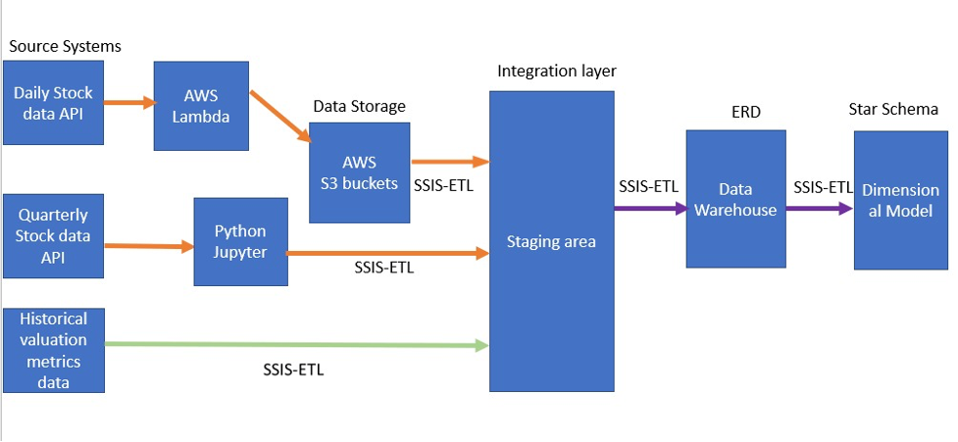
Data Architecture

Slide 6
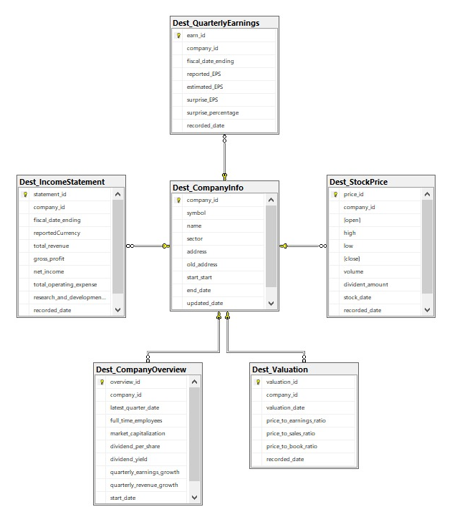
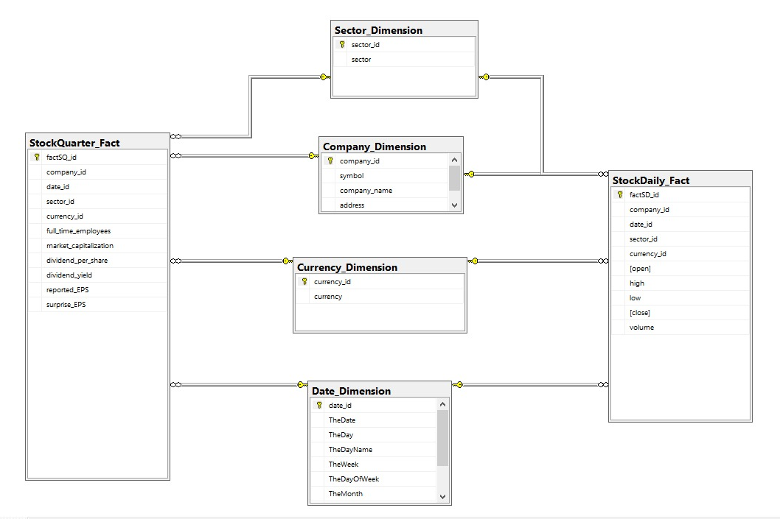
Entity–relationship Model and Star Schema
ERD Star Schema

Slide 7
Data Integration Design
ETL
Access (Extract) --Daily API stock price data extraction in AWS
Data transformations
Delivery (Loading) ---load historical data and load current data
Data Ingestion
Reference Look-up
a) currency validation
b) foriegn key validation
Slowly Changing Dimension
Process Management
Audit columns
Error handling

Slide 8
Data Integration Workflow
Steps:
Load historical data into Data Warehouse
Load historical data into Star Schema
Load current daily stock price data
Load changed address company overview data into Dest_CompanyInfo
Load changed Full time Employee Numbers company overview data into Dest_CompanyOverview
Load bad company sector into Dest_CompanyInfo
Load bad company name into Dest_CompanyOverview

Slide 9
Slowly Changing Dimensions
SCD type 2: add a new row for new data
Number of employees change in Dest_CompanyOverview
One audit column: start date
SCD type 3: add a column for historical records and overwrite with new data
Address change in Dest_CompanyInfo
Two audit columns: start date, updated date

Slide 10
Error Handling and Audit Columns
Bad sector: Sector that previously never appeared in the initial load (“Gaming”)
Bad company name: Company name starting with characters like “XX”
Example error file:

Slide 11
Analyses and Visualizations
Today’s businesses need timely information that help organizations make important decisions, meanwhile also keep a check on how their competitors are performing.
The external users such as banks who might want to give a loan and/ or investors can look at the company to see whether or not they want to do business with the company.
The datasets used will help in understanding the market and understand the profitability of the company.
Dataset 1: Stock Time Series Daily Data
Daily updated stock market raw data. New data is pulled and visualized for investors.
Dataset 2: Company Overview
Gives data for key metrics of company like revenue, earnings, market capitalization
Dataset 3: Quarterly Earning
Very important data source that showcases how company is performing compared to Wall Street estimates. Estimated and Actual EPS helps predict stock price.
Dataset 4: Income Statement
It has data on total revenue, gross profit, net income, total operating expense, etc. for each stock ticker.
Dataset 5: Valuation Data
Financial ratios (P/E ratio, P/S ratio, etc.) are integral indicators of fundamental analysis and serve as a summary of the quarterly financial statements and financial health of the company.

Slide 12
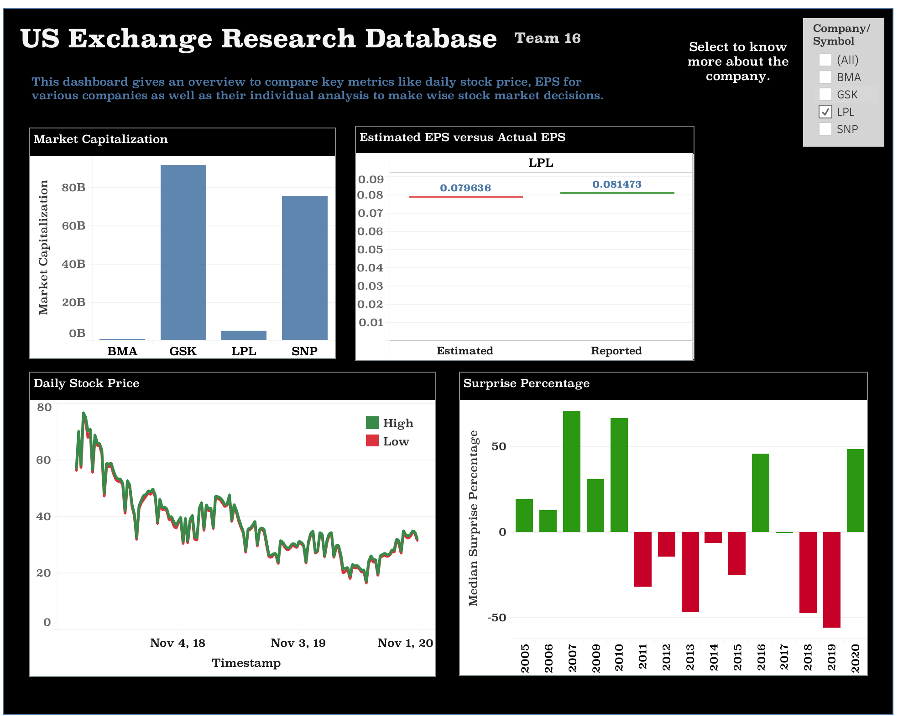
Data Analysis and Visualizations
GRAPH 1 - Market Capitalization
The average market capitalization of all the companies gives a measure of the size of the companies and its worth in the open market.
GRAPH 2 – Estimated EPS vs Actual EPS
Financial measure that indicates the profitability of the company. Estimated EPS is forecasted and acts as a good measure before investing.
GRAPH 3 – Daily Stock Price
Displays the daily stock prices, the high and low values for each company.
GRAPH 4 – Surprise Percentage
Surprise percentage can make the stock move up or down. A positive surprise generally means that a company did better than expected.

Slide 13
Conclusion
Having multiple sources with exchange information, the data warehouse in this project serves as a repository for integrated and transformed datasets providing robust information that enables prompt and profitable market analyses. This is built using tools like AWS that would automate daily API data-extraction. Through SSIS, this data will then be integrated and transformed along with other financial data and will pass through a number of lookup tasks for data validating, SCD capturing, and error handling purposes. The clean and transformed data loaded in a database with ERD and star schema. Further analysis is performed and presented in a visualization in Tableau.

Slide 14
Thank You

